Slide 1
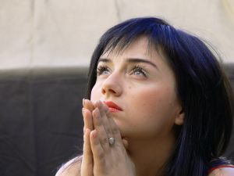
Humility

Slide 2
Test
(1)When I do something wrong, I am willing to admit my mistakes and apologise.
a. Always (3)
b. Sometimes (2)
c. Never (1)

Slide 3
(2) I always think that I am more important than others
Always (1)
Sometimes (2)
Never (3)

Slide 4
(3) I like to boast of my achievements in front of others
Always (1)
Sometimes (2)
Never (3)

Slide 5
(4) I attach great importance to contributions of each person
Always (3)
Sometimes (2)
Never (1)

Slide 6
(5)I only pay attention to my progress, without criticizing the mistakes of other people
Always (3)
Sometimes (2)
Never (1)

Slide 7
(6)Exaggerating my achievements
Always (1)
Sometimes (2)
Never (3)

Slide 8
(7)I talk more than I listen
Always (1)
Sometimes (2)
Never (3)

Slide 9

(8)I attribute my success to those who have helped me
Always (3)
Sometimes (2)
Never (1)

Slide 10

(9)When facing problems or difficulties, I like to seek opinions of others
Always (3)
Sometimes (2)
Never (1)

Slide 11
(10)If I cannot obtain the compliment I deserve, I will be angry
Always (1)
Sometimes (2)
Never (3)

Slide 12
(11)I quickly correct the mistakes of others
Always (1)
Sometimes (2)
Never (3)

Slide 13
(12)I attribute all my success and glory to God who loves me the most
Always (3)
Sometimes (2)
Never (1)

Slide 14
How many marks you have? The highest score you score, the most humble person you are

Slide 15
Humility is the Solid Foundation of all Virtues
-Confucius

Slide 16
The word humility means a lack of pride. Another definition is a modest opinion of oneself.

Slide 17
Humility is a Christian grace. With humility, we can keep our souls in peace and we can be patient during trials.

Slide 18

For I say, through the grace given to me, to everyone who is among you, not to think of himself more highly than he ought to think, but to think soberly, as God has dealt to each a measure of faith. Romans 12:3 (NKJV)
我憑著所賜我的恩、對你們各人說、不要看自己過於所當看的。要照著神所分給各人信心的大小、看得合乎中道。 （羅馬書 12：3）

Slide 19
Let nothing be done with selfish ambition or conceit, but in lowliness of mind let each esteem others better than himself.
Philippians 2:3 (NKJV)
凡事不可結黨，不可貪圖虛浮的榮耀；只要存心謙卑，各人看別人比自己強。
（腓立比書 2：3）

Slide 20
And whoever exalts himself will be humbled, and he who humbles himself will be exalted.
Matthew 23:12 (NKJV)
凡自高的，必降為卑；自卑的，必升為高。
（馬太福音 23：12）

Slide 21
And he sat down, called the twelve, and said to them, “If anyone desires to be first, he shall be last of all and servant of all. ”
Mark 9:35(NKJV)
耶穌坐下，叫十二個門徒來，說：若有人願意作首先的，他必作眾人末後的，作眾人的用人。
（馬可福音 9：35）

Slide 22
And Jesus, perceiving the thought of their heart, took a little child and set him by Him, and said to them, “Whoever receives this little child in My name receives Me; and whoever receives Me receives Him who sent Me. For he who is least among you all will be great.”
Luke 9:48(NKJV)
對他們說：凡為我名接待這小孩的，就是接待我；凡接待我的，就是接待那差我來的。你們中間最小的，他便為大。
（路加福音 9：48）

Slide 23
He has shown you, O man, what is good; and what does the Lord require of you but to do justly, to love mercy, And to walk humbly with your God?
Micah 6:8 (NKJV)
世人哪，耶和華已指示你何為善。他向你所要的是甚麼呢？只要你行公義，好憐憫，存謙卑的心，與你的神同行。（彌迦書 6：8）

Slide 24
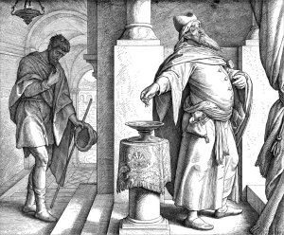
Tax Collector &Pharisee
Luke 18:13

Slide 25
Act one
Tax collector, “God, be merciful to me a sinner.”
Pharisee, “God, I am a good person. I do a lot of good things. I am better than him.”

Slide 26
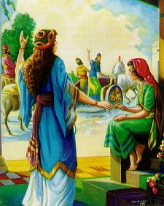
Naaman & ELisha
2 Kings 5:13

Slide 27
Act two
Naaman, “I am painful. I have leprosy. Please help me.”
Servant girl, “Elisha, Naaman has leprosy. Can you help him?”
Elisha, “Tell Naaman to dip himself seven times in the Jordan River.”
Servant girl, “Naaman, Elisha told you to dip yourself seven times in the Jordan River.”

Slide 28
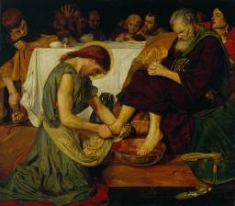
Jesus washed Disciples’ Feets
John 13:1-17

Slide 29
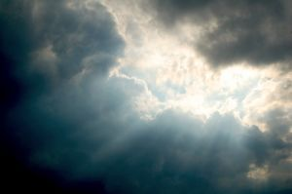
When we look at the great works of our Lord, we are humbled in His sight. We feel small when compared to the great works of God.

Slide 30
Psalm 8: 3-4," When I consider your heavens, the work of your fingers, the moon and the stars, which you have ordained, what is man that you are mindful of him, and the son of Man that you visit him? "
詩篇 8：3-4：我觀看你指頭所造的天，並你所陳設的月亮星宿，便說：人算甚麼，你竟顧念他？世人算甚麼，你竟眷顧他？

Slide 31
When we think of ourselves as unworthy, at all times thinking good of others, this is the Greatest Wisdom.

Slide 32
The great Apostle Paul said in I Timothy 1:15, “This is a faithful saying and worthy of all acceptance, that Jesus Christ came into the world to save sinners, of whom I am chief.”
提摩太前書1：15 “基督耶穌降世，為要成就罪人。”這話是可信的，是十分可佩服的。

Slide 33
No one is worthy of the enormous sacrifice that Jesus Christ made for us in our behalf.

Slide 34
Our pride is challenged when we humbly accept the love of God. When we truly see God’s magnificence we are humbled in His sight.

Slide 35
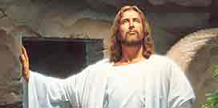
Jesus Christ, our supreme example, who served others with humility, so we should follow Him.

