Slide 1

RESPONSIBILITY
Something that it is your job or duty

Slide 2

Adam’s Tasks at Eden?
Do you know what jobs were assigned to Adam at Eden?

Slide 3
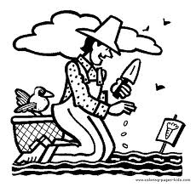
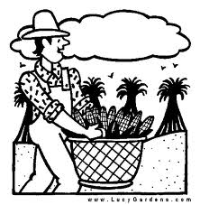
Adam was responsible for…
The Lord God took the man and put him in the Garden of Eden to work it and take care of it. (Genesis 2:15)

Slide 4
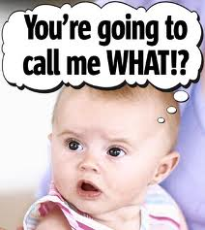
Now the Lord God had formed out of the ground all
the beasts of the field and all the birds of the air. He
brought them to the man to see what he would
name them; and whatever the man called each living
creature, that was its name.
So the man gave names
to all the livestock, the birds
of the air and all the beasts
of the field. (Genesis 2: 18-20)

Slide 5
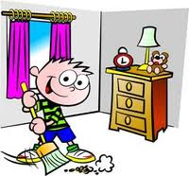
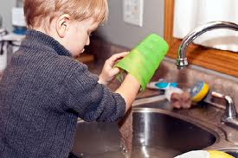

So, what responsibilities do you have…
At home?

Slide 6
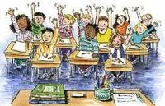

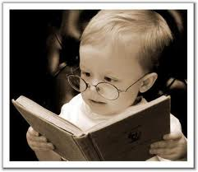
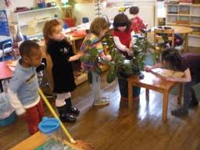
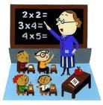
At school?

Slide 7
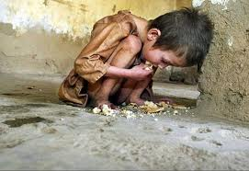



In society?

Slide 8

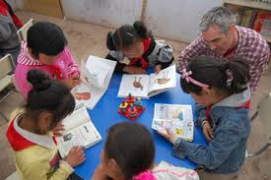


In this summer camp?

Slide 9
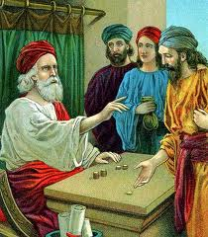
Why is responsibility important?
Matthew 25: 14 – 30

Slide 10

从前，有个主要往外国去。
主人：（对第一个仆人）我现在要往外国去，这是我的一些家业，我给你五千元，你要好好运用它。（对第二个仆人）我给你二千元，你要好好运用它。（对第三个仆人）我给你一千元，你要好好运用它。
第一个仆人领了五千元，随即拿去做买卖，另外赚了五千。第二个仆人领了二千元，也照样拿去做买卖，另赚了五千。第三个仆人领了一千元，随即去掘开地，把主人的银子埋藏了。过了许久，那些仆人的主人回来了。

Slide 11
主人：我给了你的那些钱，你怎样运用呢？
第一个仆人：主人，你交给我五千元，请看，我又赚了五千。
主人：好！你这又良善、又忠心的仆人，你在不多的事上有忠心，我要把许多事派你管理。可以进来享受你主人的快乐。
第二个仆人：主人，你交给我二千元，请看，我又赚了二千。

Slide 12
主人：好！你这又良善、又忠心的仆人，你在不多的事上有忠心，我要把许多事派你管理。可以进来享受你主人的快乐。
第三个仆人：主人，我把你的一千银子埋藏在地里，请看，你的原银子在这里。
主人：你这不负责任的懒仆人！你没有好好运用我给你的家业，你可以把我的银子放在银行，到我来的时候，可以连本带利收回。我现在要夺回你那一千元给那有一万的。你这不负责任的懒仆人，到外面的黑暗里去吧！

Slide 13
How much money did the Master give the three servants respectively?
How did the first servant use the money?
How did the second servant use the money?
How did the third servant use the money?
What did the Master say to the first servant?
What did the Master say to the second servant?
What did the Master say to the third servant?

Slide 14
What is the most important responsibility we have?
“Fear God and keep his commandments, for this is the whole duty of man.
For God will bring every deed into judgment, including every hidden thing, whether it is good or evil.” (Ecc12:13-14)
「 ……敬畏神，谨守他的诫命，这是人所当尽的本分。因为人所做的事，无论是善是恶，神都必审问。」（传道书 12: 13-14）

